Slide 1
Consultation on the Finance Sector Supplement to the Natural Capital Protocol
This project has been made possible by generous funding and support from The Rockefeller Foundation, International Finance Corporation (IFC) with the support of the Swiss State Secretariat for Economic Affairs (SECO) and the Ministry of Foreign Affairs of the Government of the Netherlands, United Nations Environment Program (UNEP), and the Dutch Ministry of Economic Affairs.

Slide 2
Background

Slide 3
The Natural Capital Protocol
The Natural Capital Protocol was launched in July 2016.
It provides a standardized global framework for businesses to integrate natural capital into their decisions.

Slide 4
The Finance Sector Supplement
In October 2016, the Natural Capital Coalition, the Natural Capital Finance Alliance (NCFA) and the Dutch Association of Investors for Sustainable Development (VBDO) announced that they would produce a Finance Sector Supplement to the Natural Capital Protocol.
The Supplement will help financial institutions incorporate consideration of natural capital impacts and dependencies into their lending, investment and insurance practices and processes.
At present, there is no agreed framework for financial institutions to measure and value their impacts and dependencies on natural capital.

Slide 5
Proposed timeline
Launch
Draft preparation
Publication
October 2016
Jan - Mar 2017
Sept 2017
Nov - Dec 2016
Apr – Jun 2017
Engagement
Consultation
The Briefing Paper and consultation response survey can be found at http://naturalcapitalcoalition.org/projects/finance-sector-supplement/

Slide 6
Natural Capital and the Finance Sector:
Key Concepts

Slide 7
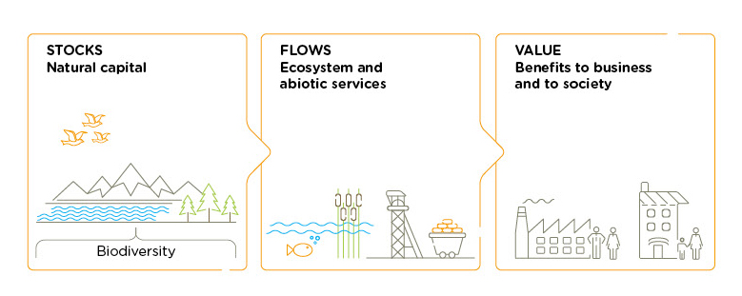
What is natural capital?
Natural Capital is the stock of renewable and non-renewable natural resources, (e.g. plants, animals, air water, soils, minerals) that combine to yield a flow of benefits to people.
Source: Natural Capital Protocol
Notes:
This is the agreed upon definition of natural capital as used by over 200 leading organizations within the Coalition.

Slide 8
The other forms of capital
There are several commonly recognized forms of capital.
It is natural capital that supports all of the other forms of capital and underpins thriving societies and prosperous economies.
All capitals are interconnected and it is impossible to completely separate any one form of capital from the others.
Financial capital
Manufactured capital
Intellectual capital
Human capital
Social and relationship capital
Natural capital
The <IR> capitals framework

Slide 9
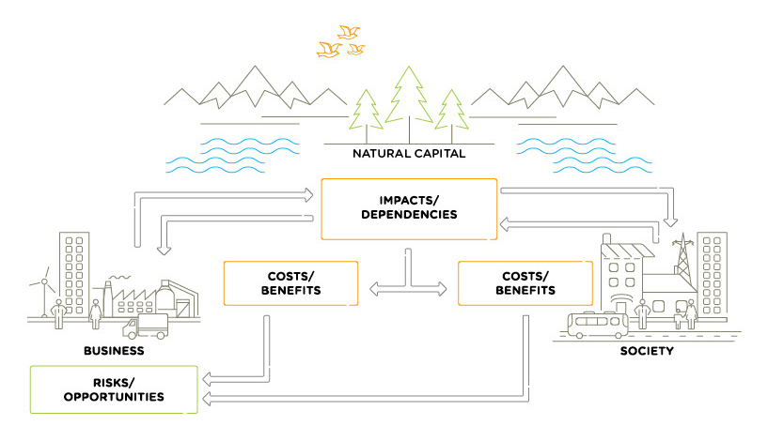
Interactions with natural
capital
The management of these risks and opportunities requires a practical, globalized, consistent approach.

Slide 10
Why should the finance sector be interested in natural capital?
Companies’ impacts and dependencies on natural capital create business risks and opportunities, affecting cashflows, profits and asset valuations.
In turn, these may affect insurance premiums, project valuations, equity prices or the cost of capital.
Natural capital also has wider implications; for example, finance institutions might have significant exposure to water or biodiversity-related risks because of their aggregate exposure to specific geographies, sectors or markets.

Slide 11
What makes the Finance Sector Supplement different?
Financial institutions, like other organizations, have impacts and dependencies on natural capital.
Framing natural capital as being about impacts and dependencies encourages financial institutions to:
Focus on their wider business activities (lending, investment, insurance) not just their own operations.
Focus on the value of natural capital to their business.
Take a systems approach to decision-making.

Slide 12
High Level Consultation
on the Finance Sector Supplement

Slide 13
Aims
To understand what would help financial institutions to incorporate natural capital considerations into their risk management frameworks, products and services.
To gather feedback on how the Finance Sector Supplement should be structured and presented.
The consultation is looking for feedback on three key topics:
The state of play: natural capital in the finance sector.
The scope of the Supplement.
The structure and content of the Supplement.

Slide 14
State of play:
Interest and relevance
How important is natural capital in your organization’s decision-making processes?
What do you see as the key challenges to integrating natural capital into your organization’s decision-making processes?
Would a Finance Sector Supplement be useful for your organization?
What do you see as the primary contribution(s) of a Finance Sector Supplement?

Slide 15
Scope of the Supplement
Do you agree that the Finance Sector Supplement should focus on the banking, investment, and insurance sub-sectors? Should the Supplement cover other sectors?
Should we prepare one overarching supplement for the entire finance sector or separate supplements for each sub-sector?
Do particular finance sector actors have specific needs and interests that need to be taken into account when developing the Supplement?

Slide 16
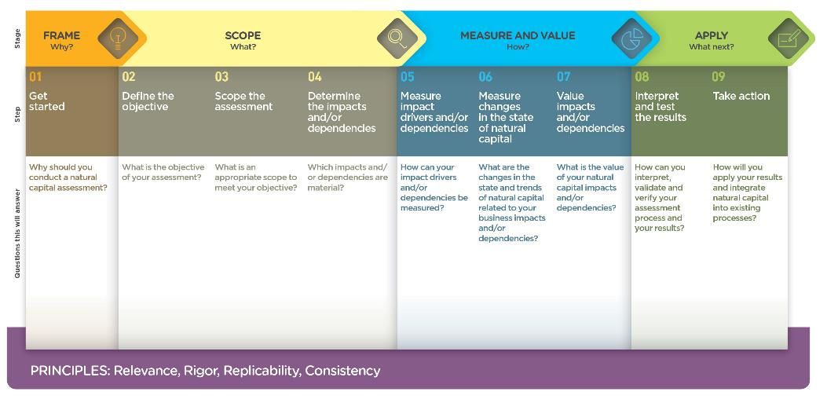
Structure and content of the Supplement
Should the Finance Sector Supplement follow the established decision-making process of the Natural Capital Protocol? If not, can you suggest an alternative structure?

Slide 17
To find out more: info@naturalcapitalcoalition.org

